Slide 1









RECYCLING
REVOLUTION APP
SaafPakistan
LETS PAINT PAKISTAN GREEN!
Ali Sher (F2020-158)
Nouman Ali (F2020-149)
Mian Faizan Munawer (F2020-148)

Slide 2
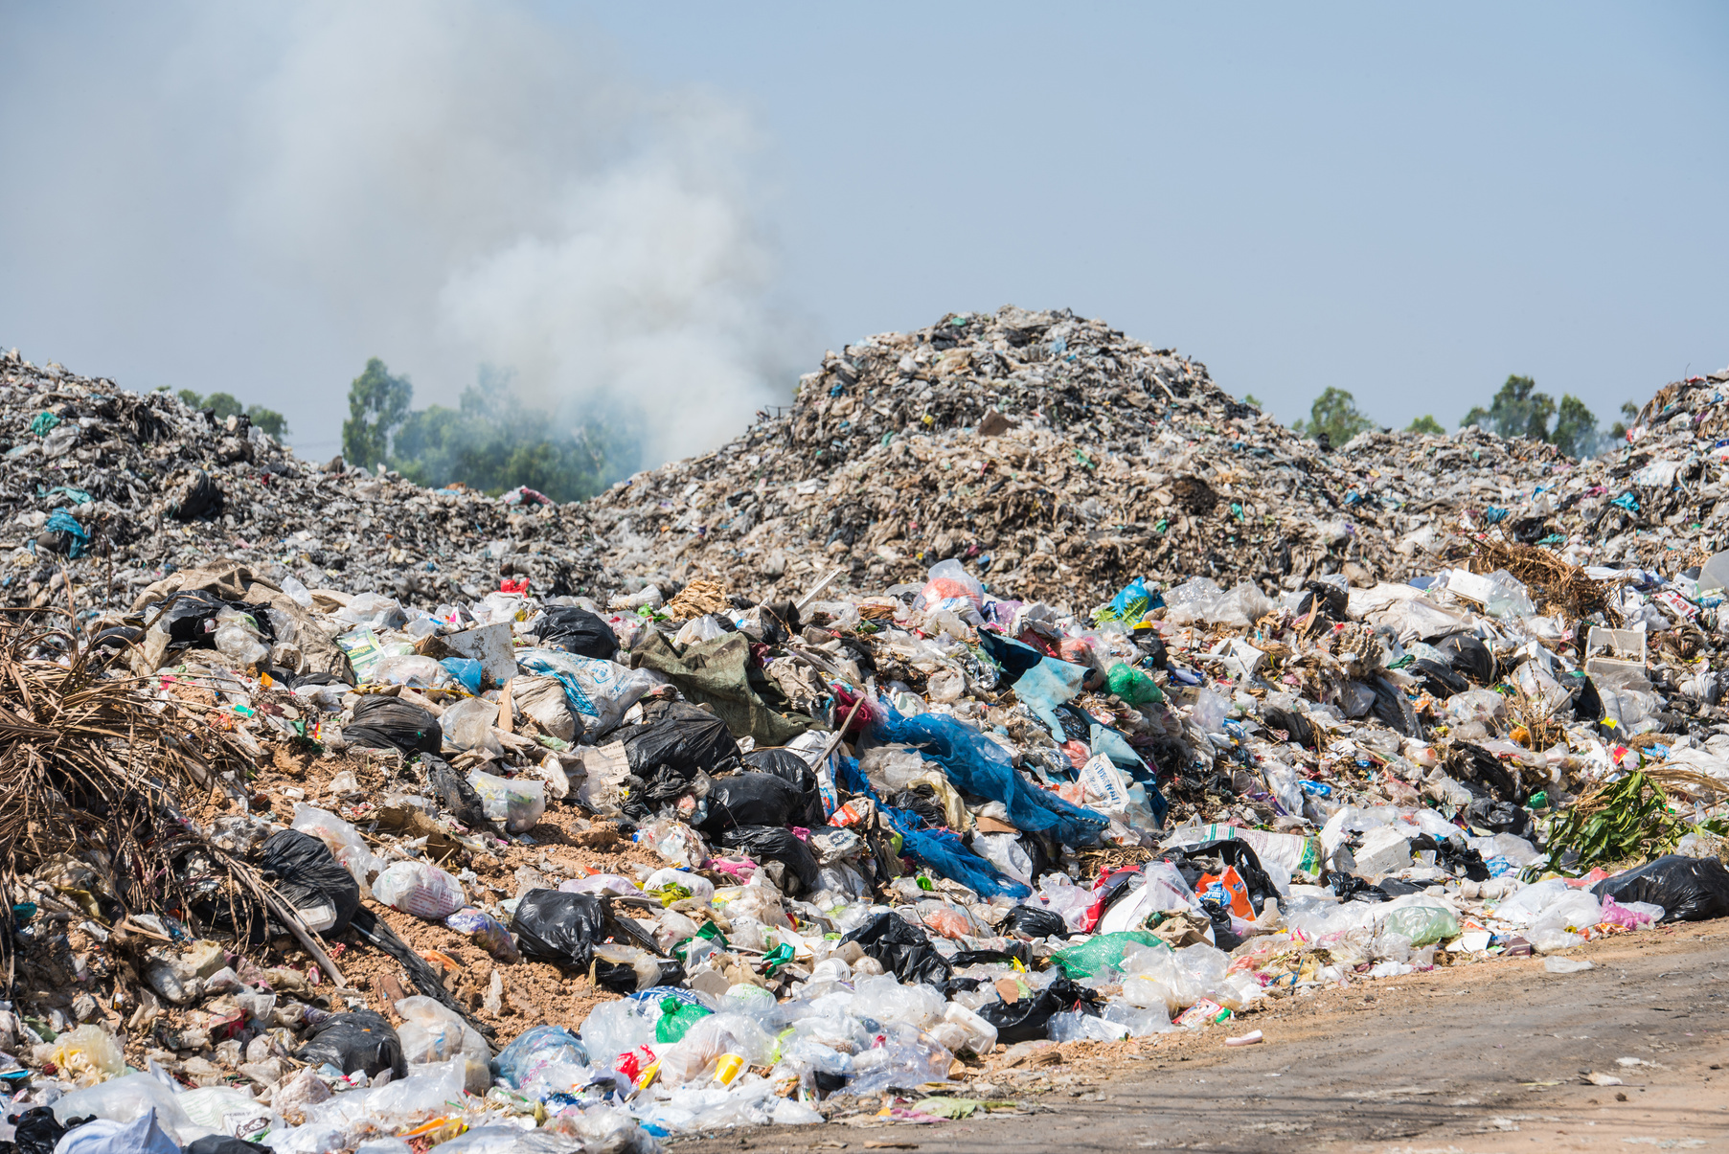
Problem
Pakistan's unstructured recycling system leads to disorganized waste disposal, causing environmental pollution and recyclable accumulation in landfills.

Slide 3
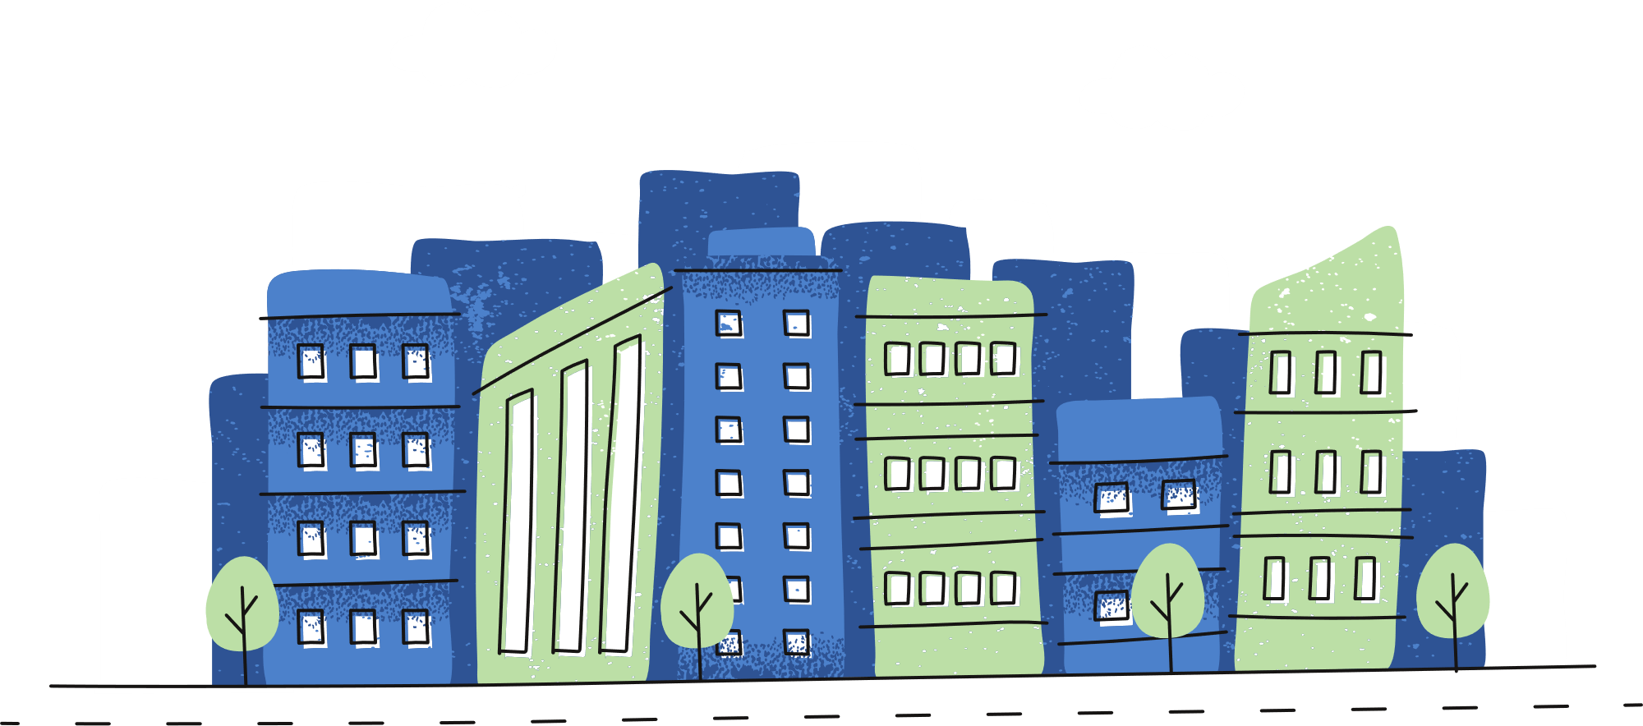
Statistics
Solid Waste Generation
City | Recyclable Waste Generated Daily/ Tons
Karachi | 16,500
Lahore | 7,690
Faisalabad | 5,017
Rawalpindi | 4,500
Hyderabad | 3,973
Pakistan waste generation grows 2.4% annually
Lahore Generates 7690 tons of waste on a daily basis
Only 27% of generated waste is being is recycled in Lahore
[1]
[1]
[2]
Solid Waste Generation In Major Cities
[1]
Waste Management in Pakistan (2022)by the U.S. Trade and Development Agency
Azam, M., et al. (2019). "Status, characterization, and potential utilization of municipal solid waste as a renewable energy source: Lahore case study in Pakistan."

Slide 4
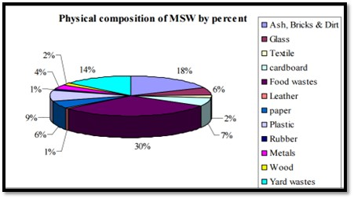
Solid Waste Breakdown
35% of the generated solid waste make up for the most valued recycling materials which equals to 2695 Tons
Plastic
Cardboard
Paper
Metals
[1]
Composition of municipal solid waste
Waste Management in Pakistan (2022) by the U.S. Trade and Development Agency

Slide 5
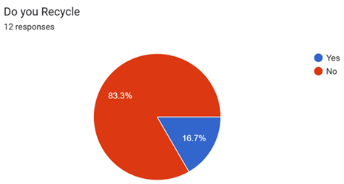
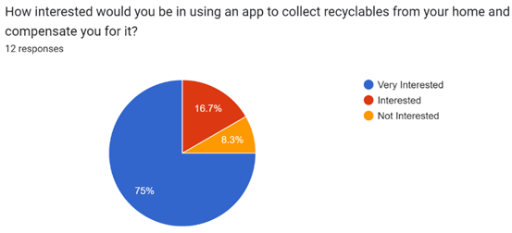
Survey
83% of the people do not recycle because there are no means for recycling.
75% percent of the people said that they would start recycling if it were made convenient by an app

Slide 6
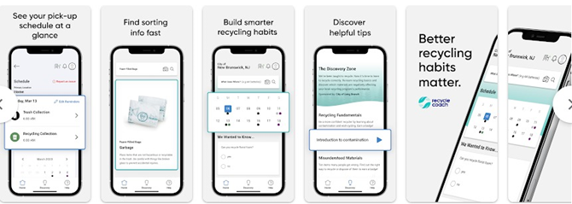
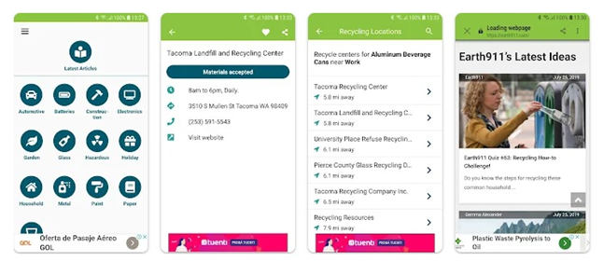
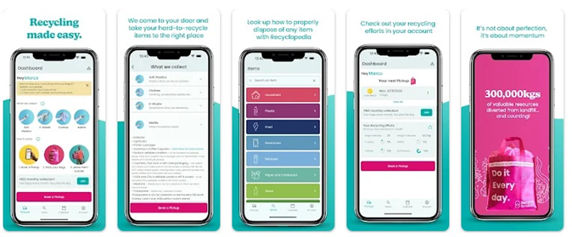
Existing Solutions
Recycle Coach Mobile App
iRecycle Mobile App
Recycle Smart Mobile App

Slide 7

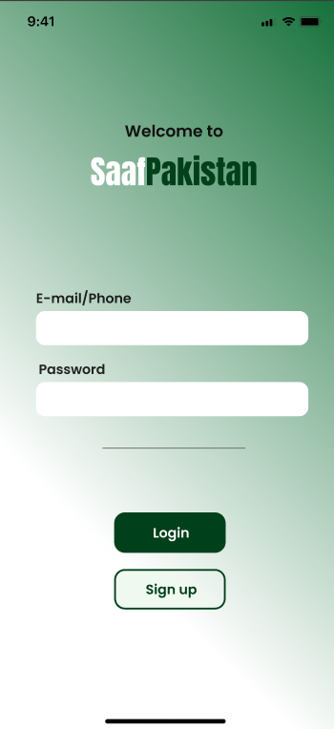
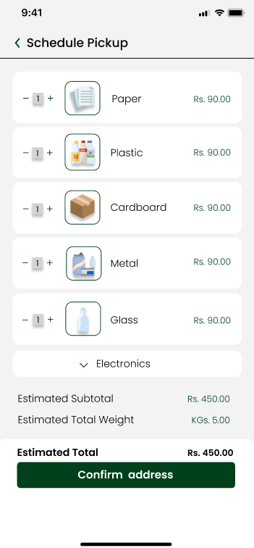
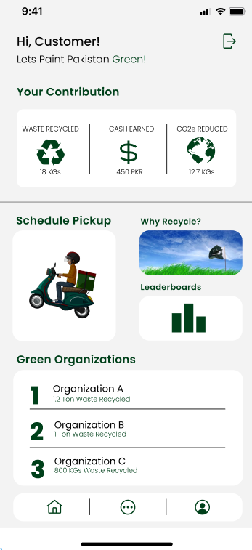
Solution
"Introducing SaafPakistan: Your App for a Cleaner, Greener Tomorrow!"

Slide 8
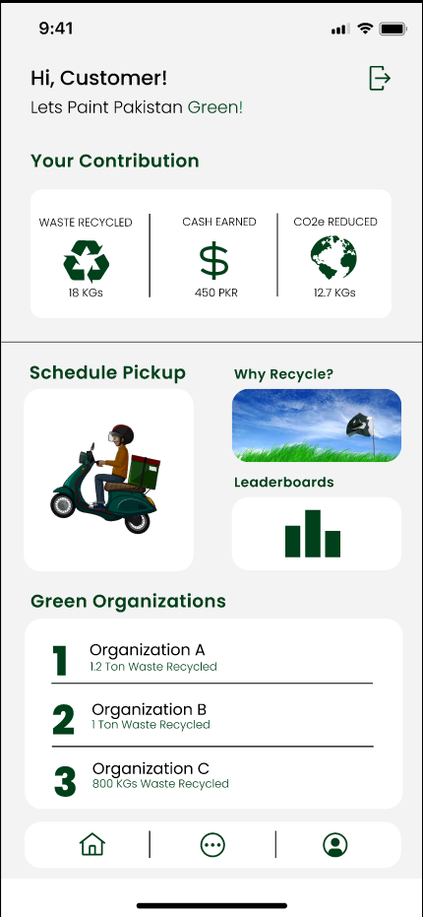
Features
Progress
Get updated of your real-time progress
Educational Content
Schedule Pickup for Recycling
Gamification
A dynamic leaderboard system for individuals and businesses, fostering a sense of competition.
Compete against friends
For Green Marketing

Slide 9

Business Model
"Our business model is simple: We buy at competitive rates from individuals and businesses and sell at premium rates to recycling centers, creating a sustainable and profitable recycling ecosystem."

Slide 10
Business Model
Individuals
Businesses
Item | Recycle Center Buying Rates (PKR/KG) | Individuals Selling Rates (PKR/KG)
Plastic | 90 | 70
Steel | 260 | 230
Paper | 100 | 80
Cardboard | 36 | 20
Item | Recycle Center Buying Rates (PKR/KG) | Business/Industries Selling Rates (PKR/KG)
Paper | 100 | 57
Fabric Waste | 90 | 58
Paper Cones | 50 | 32
L/Cut Pieces | 150 | 117
Source: Cheema Metal Scraps
Source: Active Apparels PVT LTD
Source: Warraich Scrap Dealers
Source: Three Stars Hosiery Mills PVT LTD

Slide 11
Business Model
[1]
[2]
Out of the 2695 tons only 27% is being recycled, leaving 1967 tons of valuable recyclable waste up for grabs on daily basis
For the Individuals side of the model 24rs per kg is the average gross profit
With just 50 tons monthly we expect to generate a revenue of 1.2 Million PKR
For Businesses side of the model 31.5rs per kg is the average gross profit
With just 100 tons monthly we expect to generate a revenue of 3.15 Million PKR
Average cost to run the business would be between 35-40% of the gross profit.
Leaving us with a net profit of 2.61 Million PKR with just 150 Tons/Month
Waste Management in Pakistan (2022)by the U.S. Trade and Development Agency
Azam, M., et al. (2019). "Status, characterization, and potential utilization of municipal solid waste as a renewable energy source: Lahore case study in Pakistan."

Slide 12
Technologies
Deliverables
Next.js (Front End)
Spring Boot (Back End)
React Native (Front End)
Figma (Prototypes)
Postman (API Testing)
GitHub (Code Sharing)
WebApp (Admin Dashboard)
Mobile App (Consumer/Rider)

Slide 13
References
https://www.trade.gov/country-commercial-guides/pakistan-waste-management
https://www.sciencedirect.com/science/article/pii/S0160412019322986

Slide 14
Now the Prototype

